Slide 1
Tetranucleotide Usage in Mycobacteriophage Genomes
alignment-free methods to cluster phage and infer evolutionary relationships
CHEN YE benjamin siranosian | emma herold | minjae kwon | sudheesha perera edward williams | sarah taylor | christopher degraffenreid
all the things are preliminary + subject to change

Slide 2
Introduction + Background

Slide 3
Construct phylogenetic tree
Categorize phage into subclusters
Identify anomalies

Slide 4
TUDs

Slide 5
(normally, a pretty informative animation would be here)
but it’s not done yet :-(

Slide 6
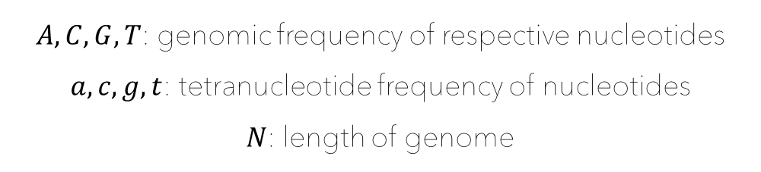

$$E\left(w\right)=[\left(A^{a}∗C^{c}∗G^{g}∗T^{t}\right)∗N−3]$$
$A, C, G, T$: genomic frequency of respective nucleotides
$a, c, g, t$: tetranucleotide frequency of nucleotides
$N$: length of genome

Slide 7

$$T(w)=\frac{observed}{expected}$$

Slide 8
Hierarchical Clustering + Neighbor Joining

Slide 9
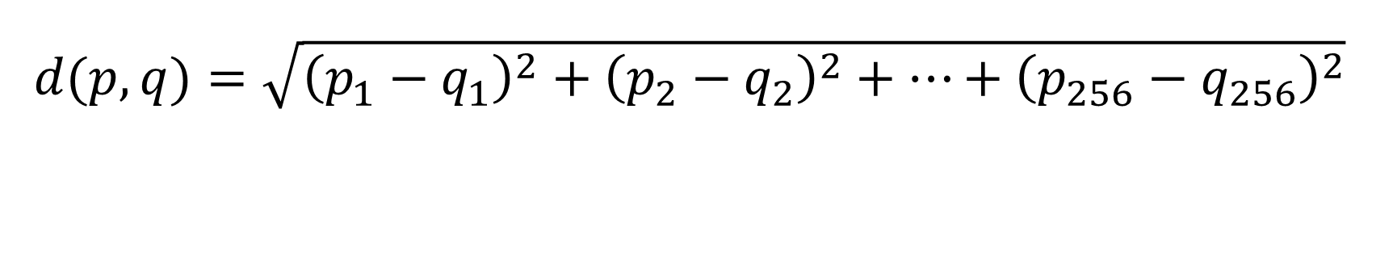
$$d(p,q)=\sqrt{{\left(p_{1}−q_{1}\right)}^{2}+{\left(p_{2}−q_{2}\right)}^{2}+…+{\left(p_{256}−q_{256}\right)}^{2}}$$

Slide 10
(normally, a pretty informative animation would be here)
but it’s not done yet :-(

Slide 11
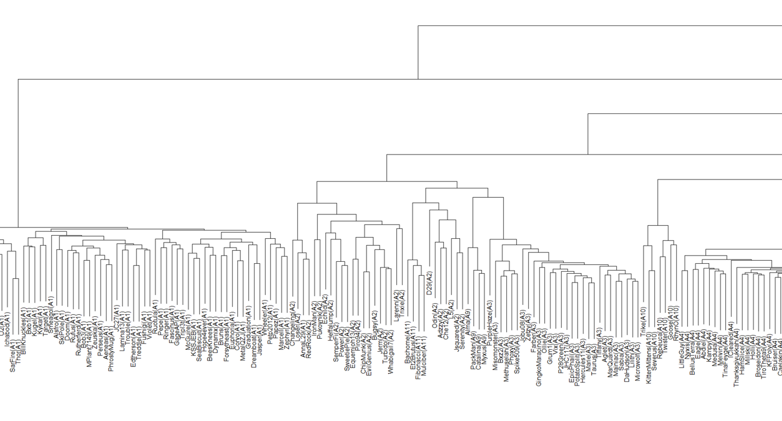

Slide 12
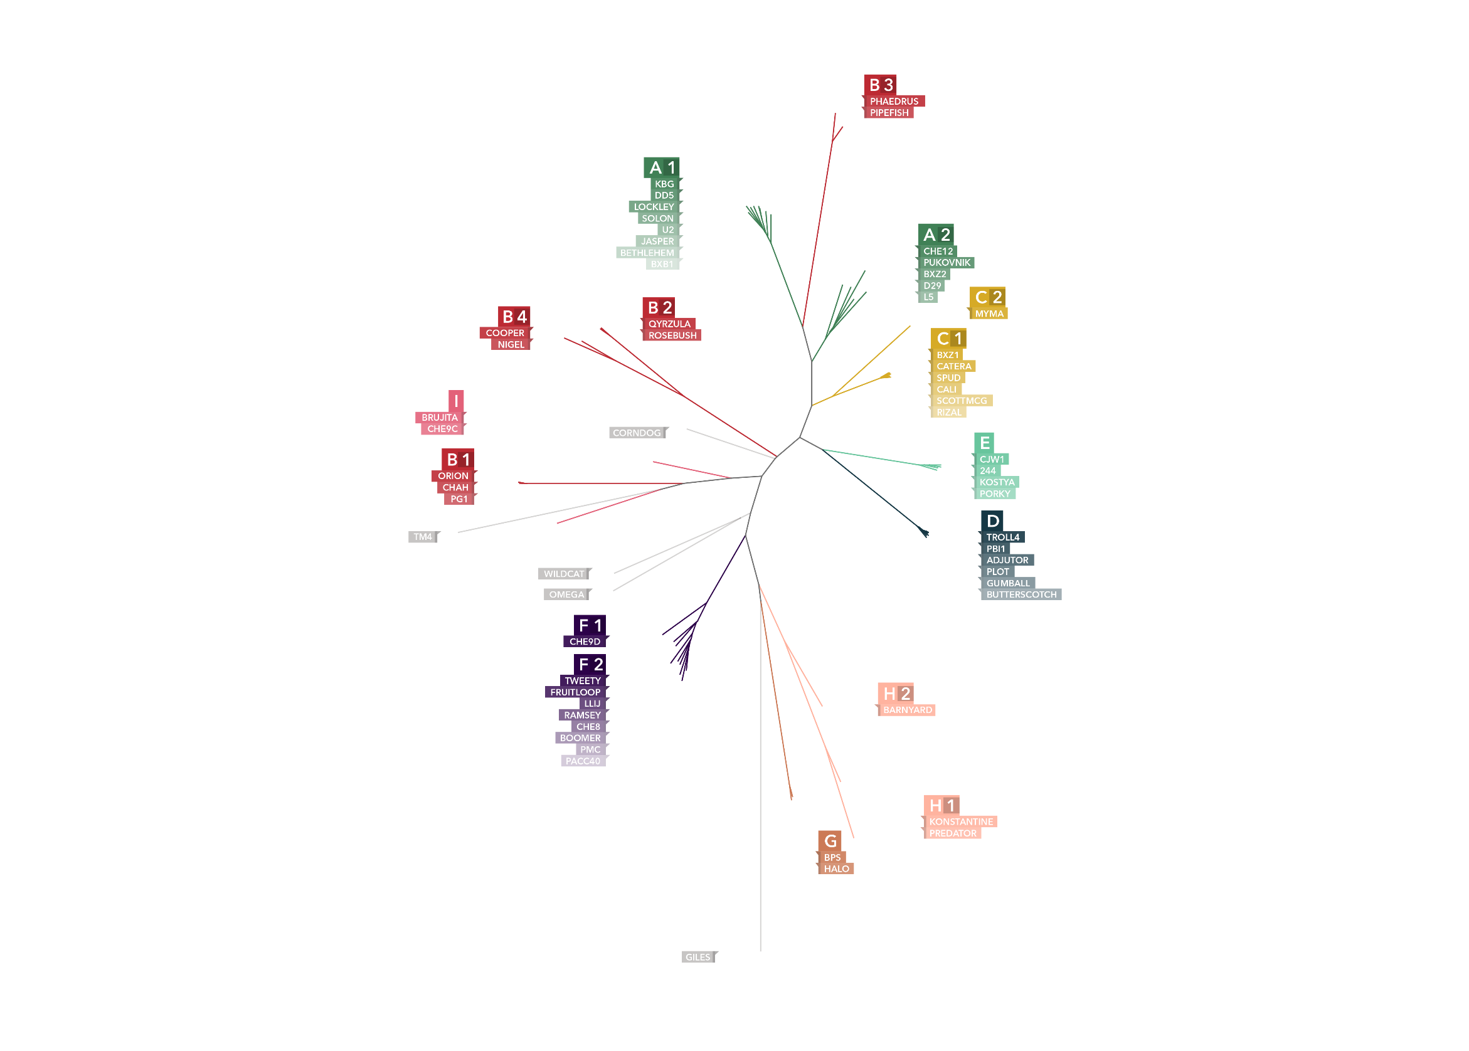

Slide 13
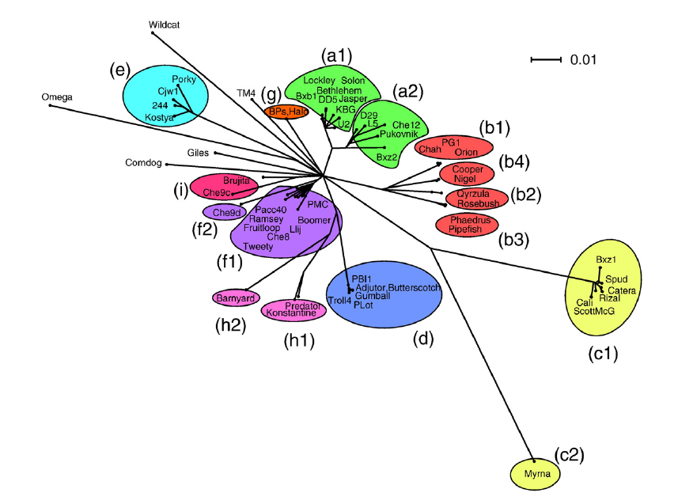

Slide 17
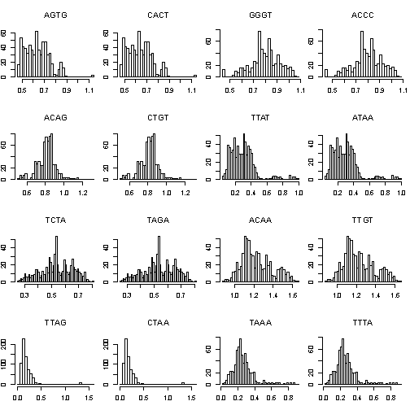
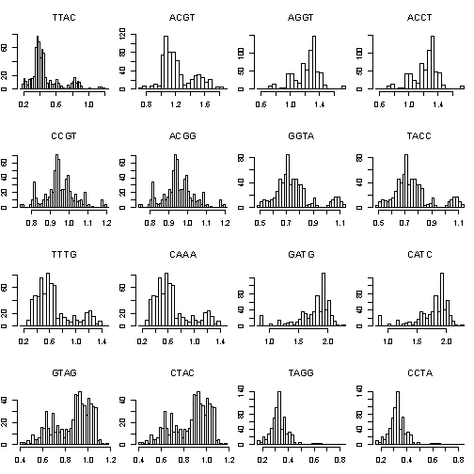
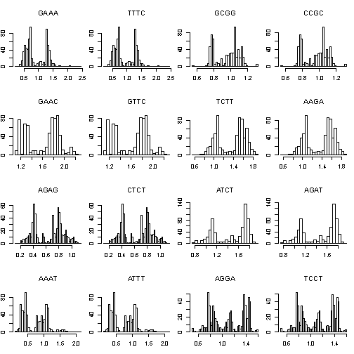
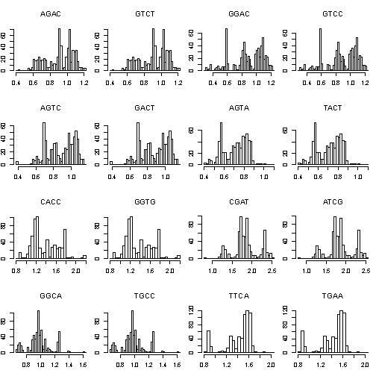
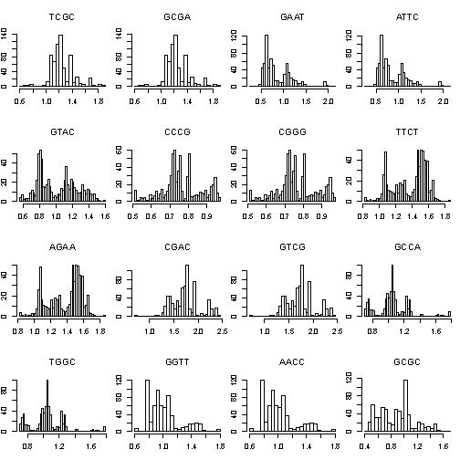
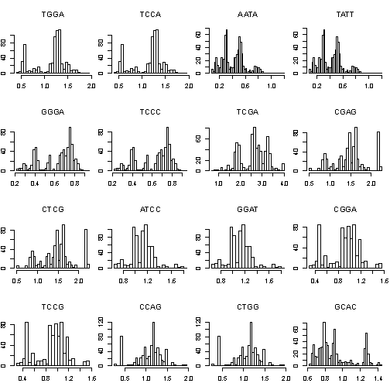
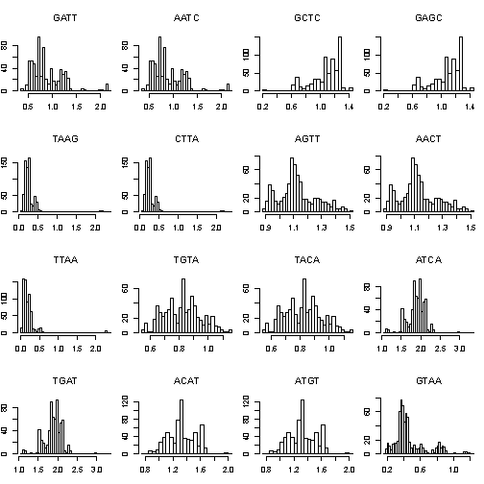
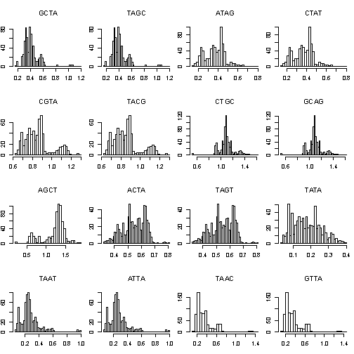
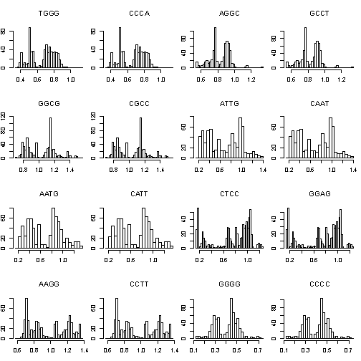
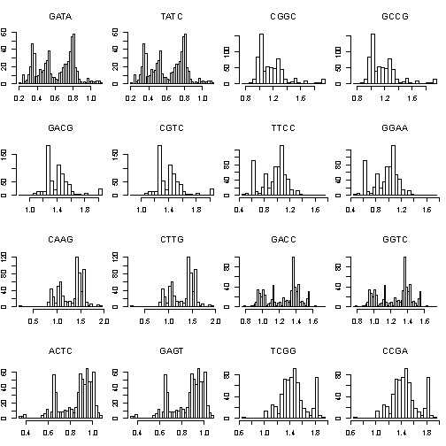
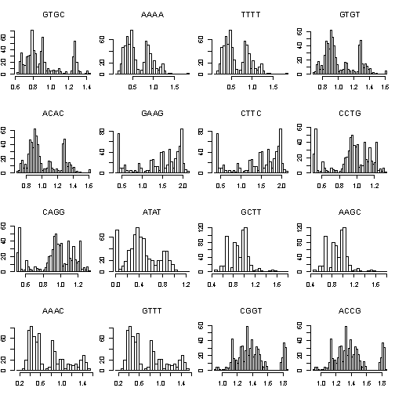
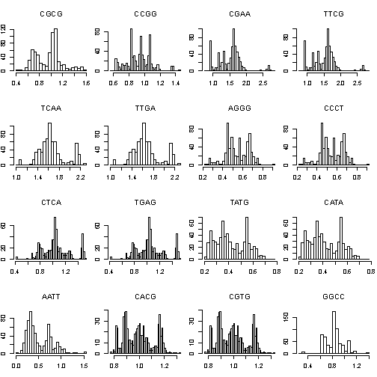
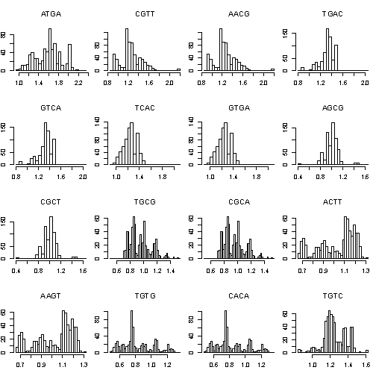
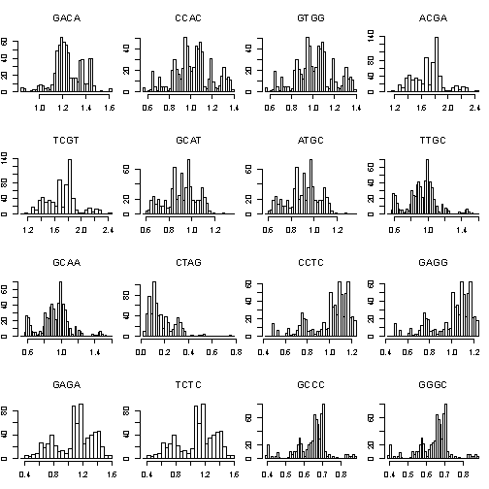
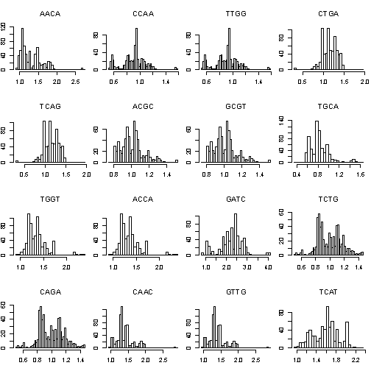
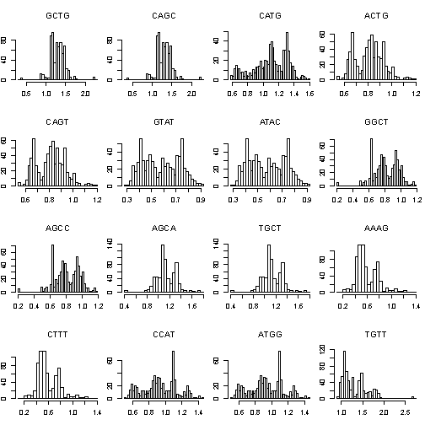

Slide 18
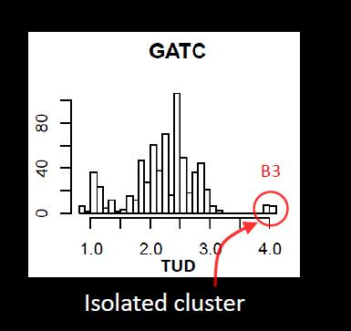
(preliminary graphic)

Slide 19
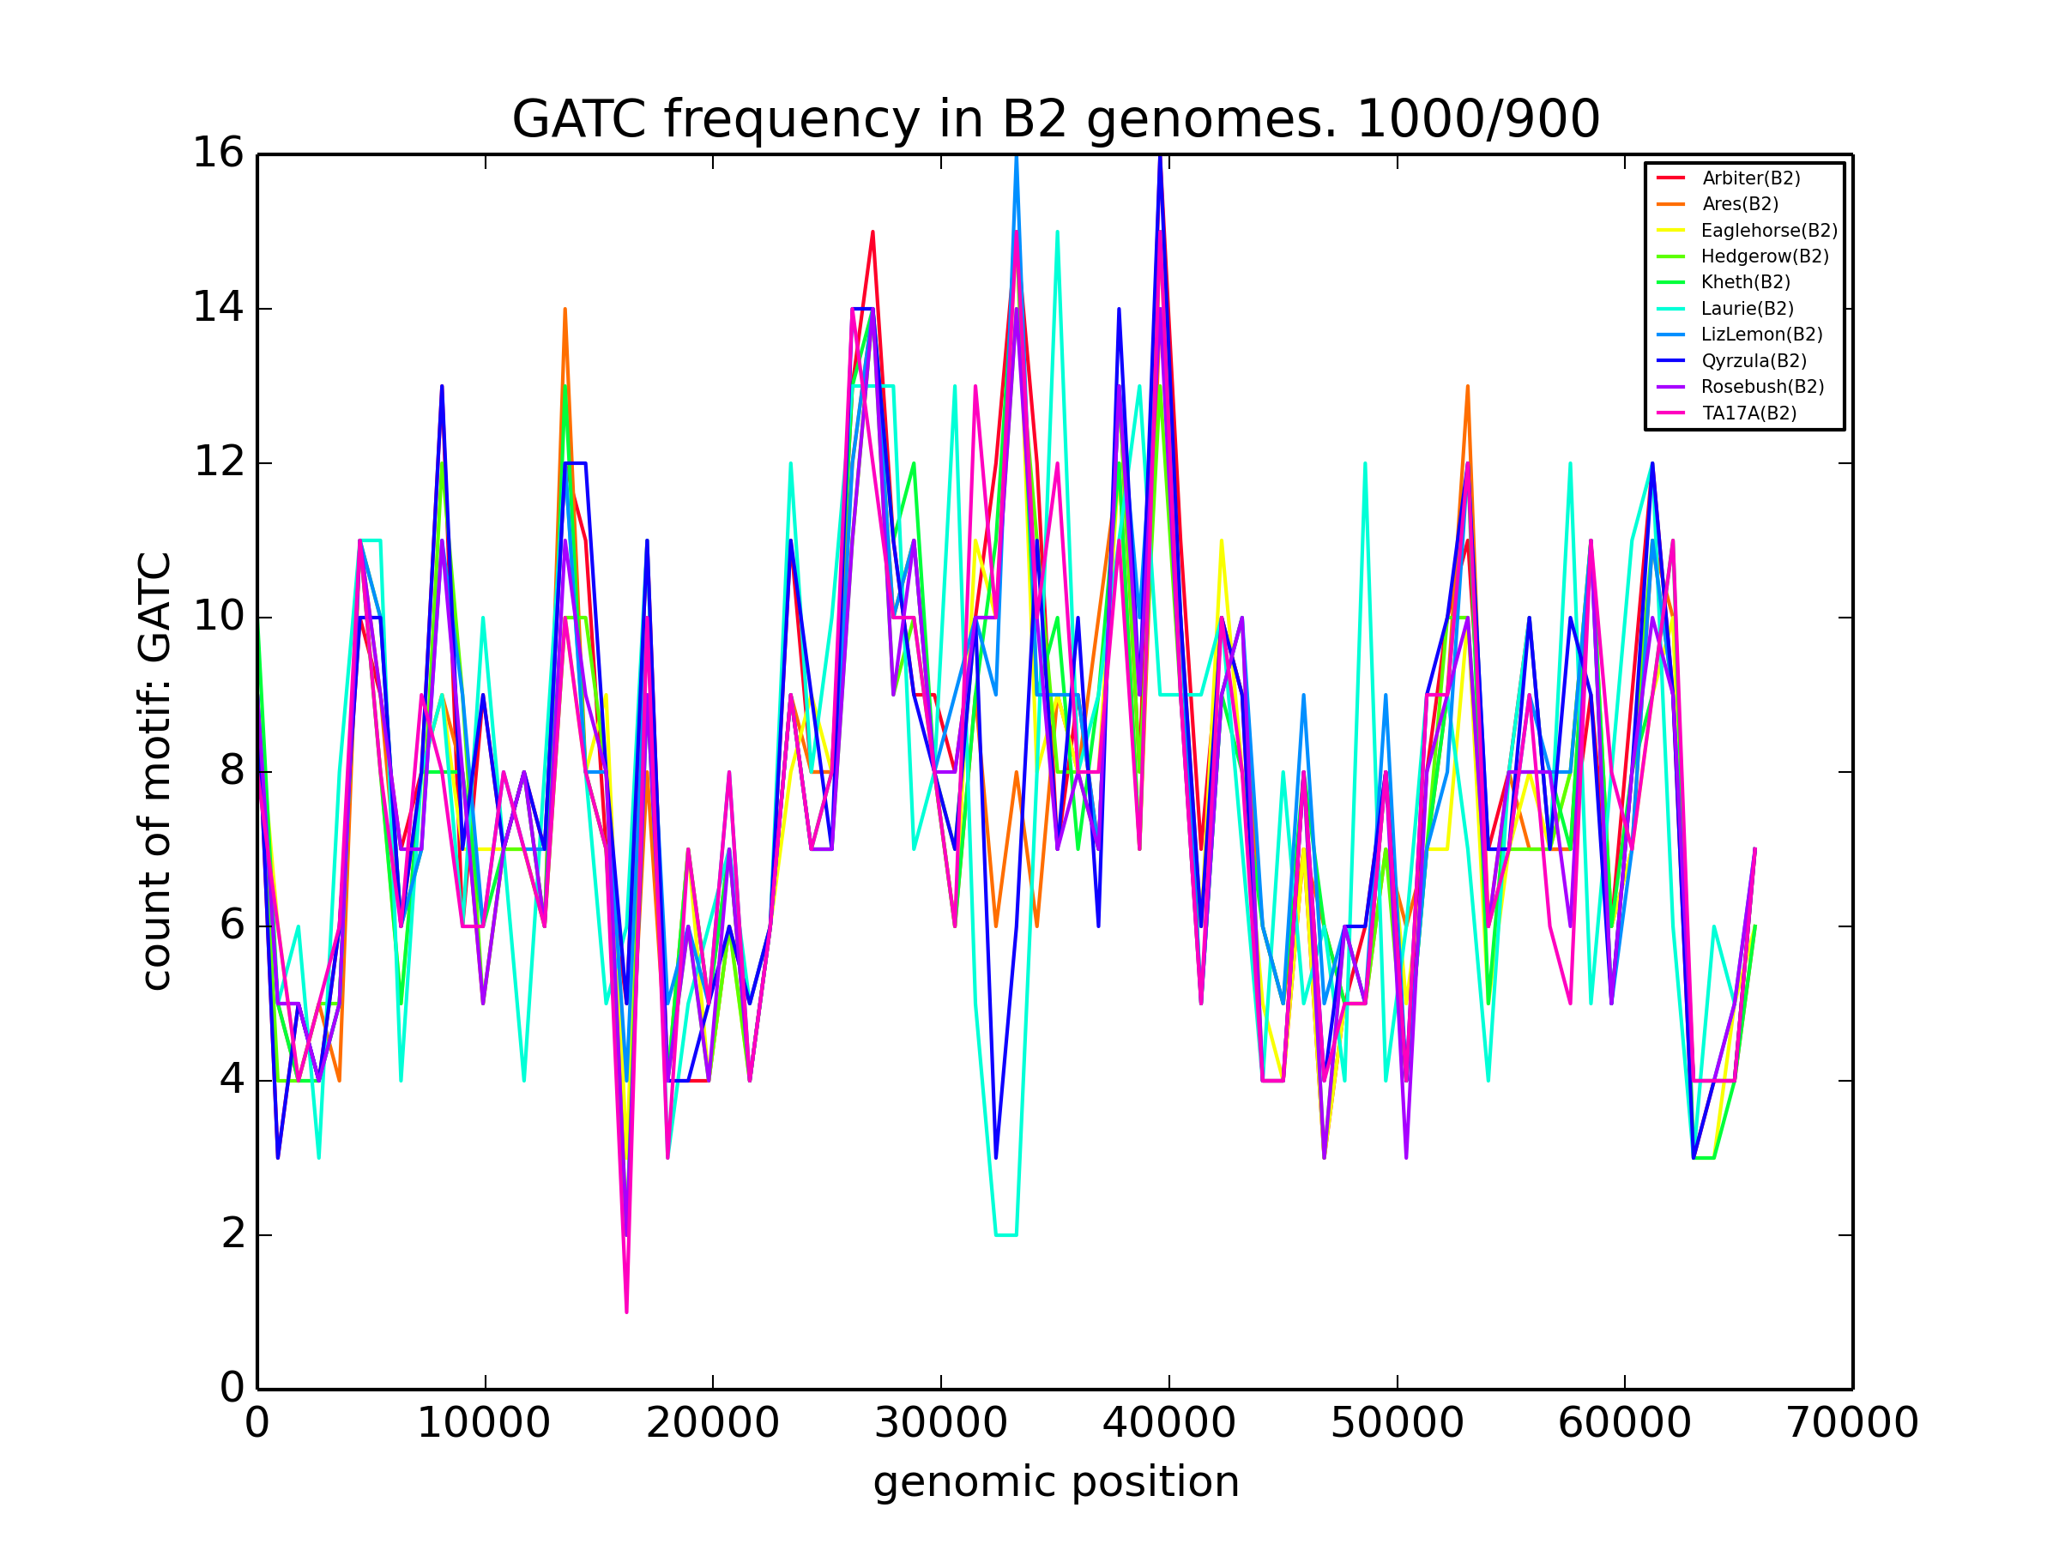

Slide 20
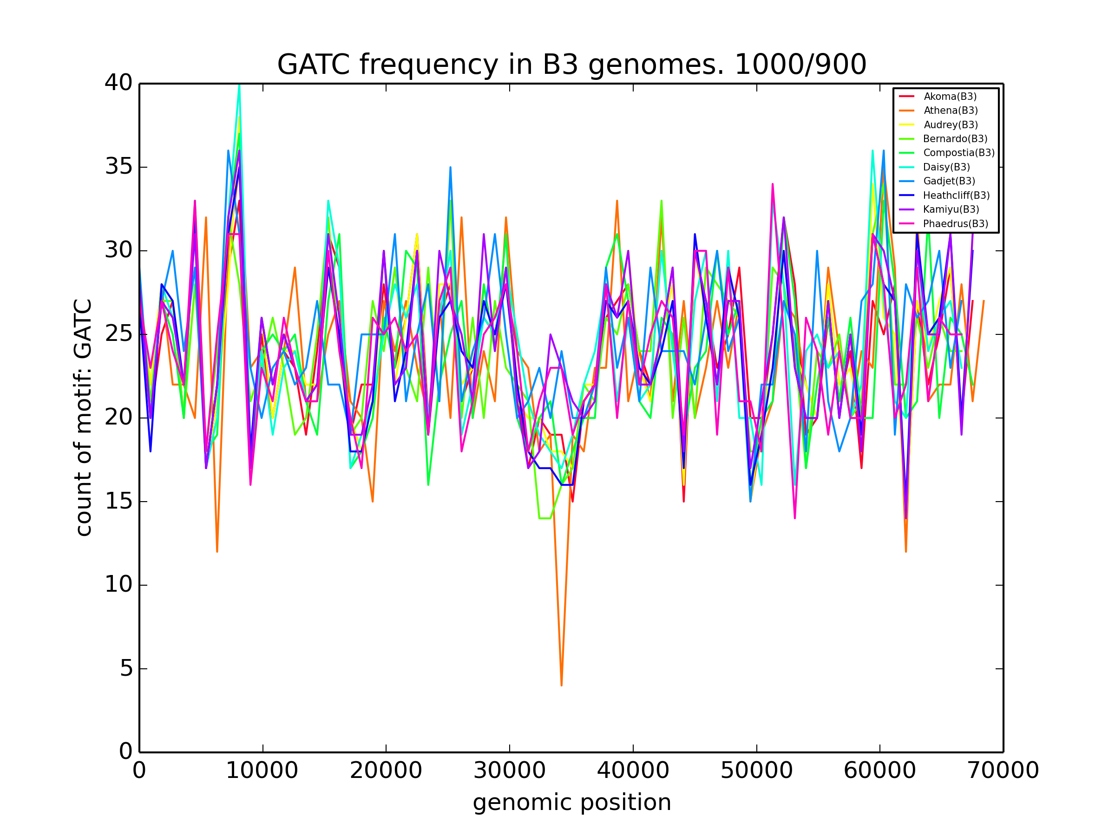

Slide 21
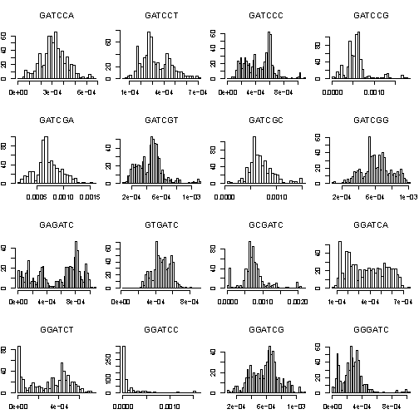

Slide 22
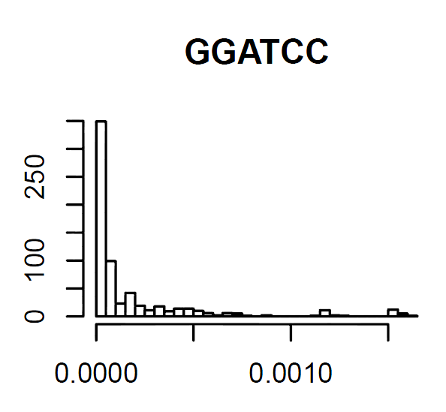
B3
(preliminary graphic)

Slide 23
B3 figures here

Slide 24
KNN Classifier

Slide 25
Correctly Classified Instances: 641 98.0122% Incorrectly Classified Instances: 13 1.9878 %

Slide 26
Tetranucleotide Difference Index

Slide 27
(normally, a pretty informative animation would be here)
but it’s not done yet :-(

Slide 28

$$\sum_{j}^{i}{|T−T_{w}\left(W\right)|}$$

Slide 29
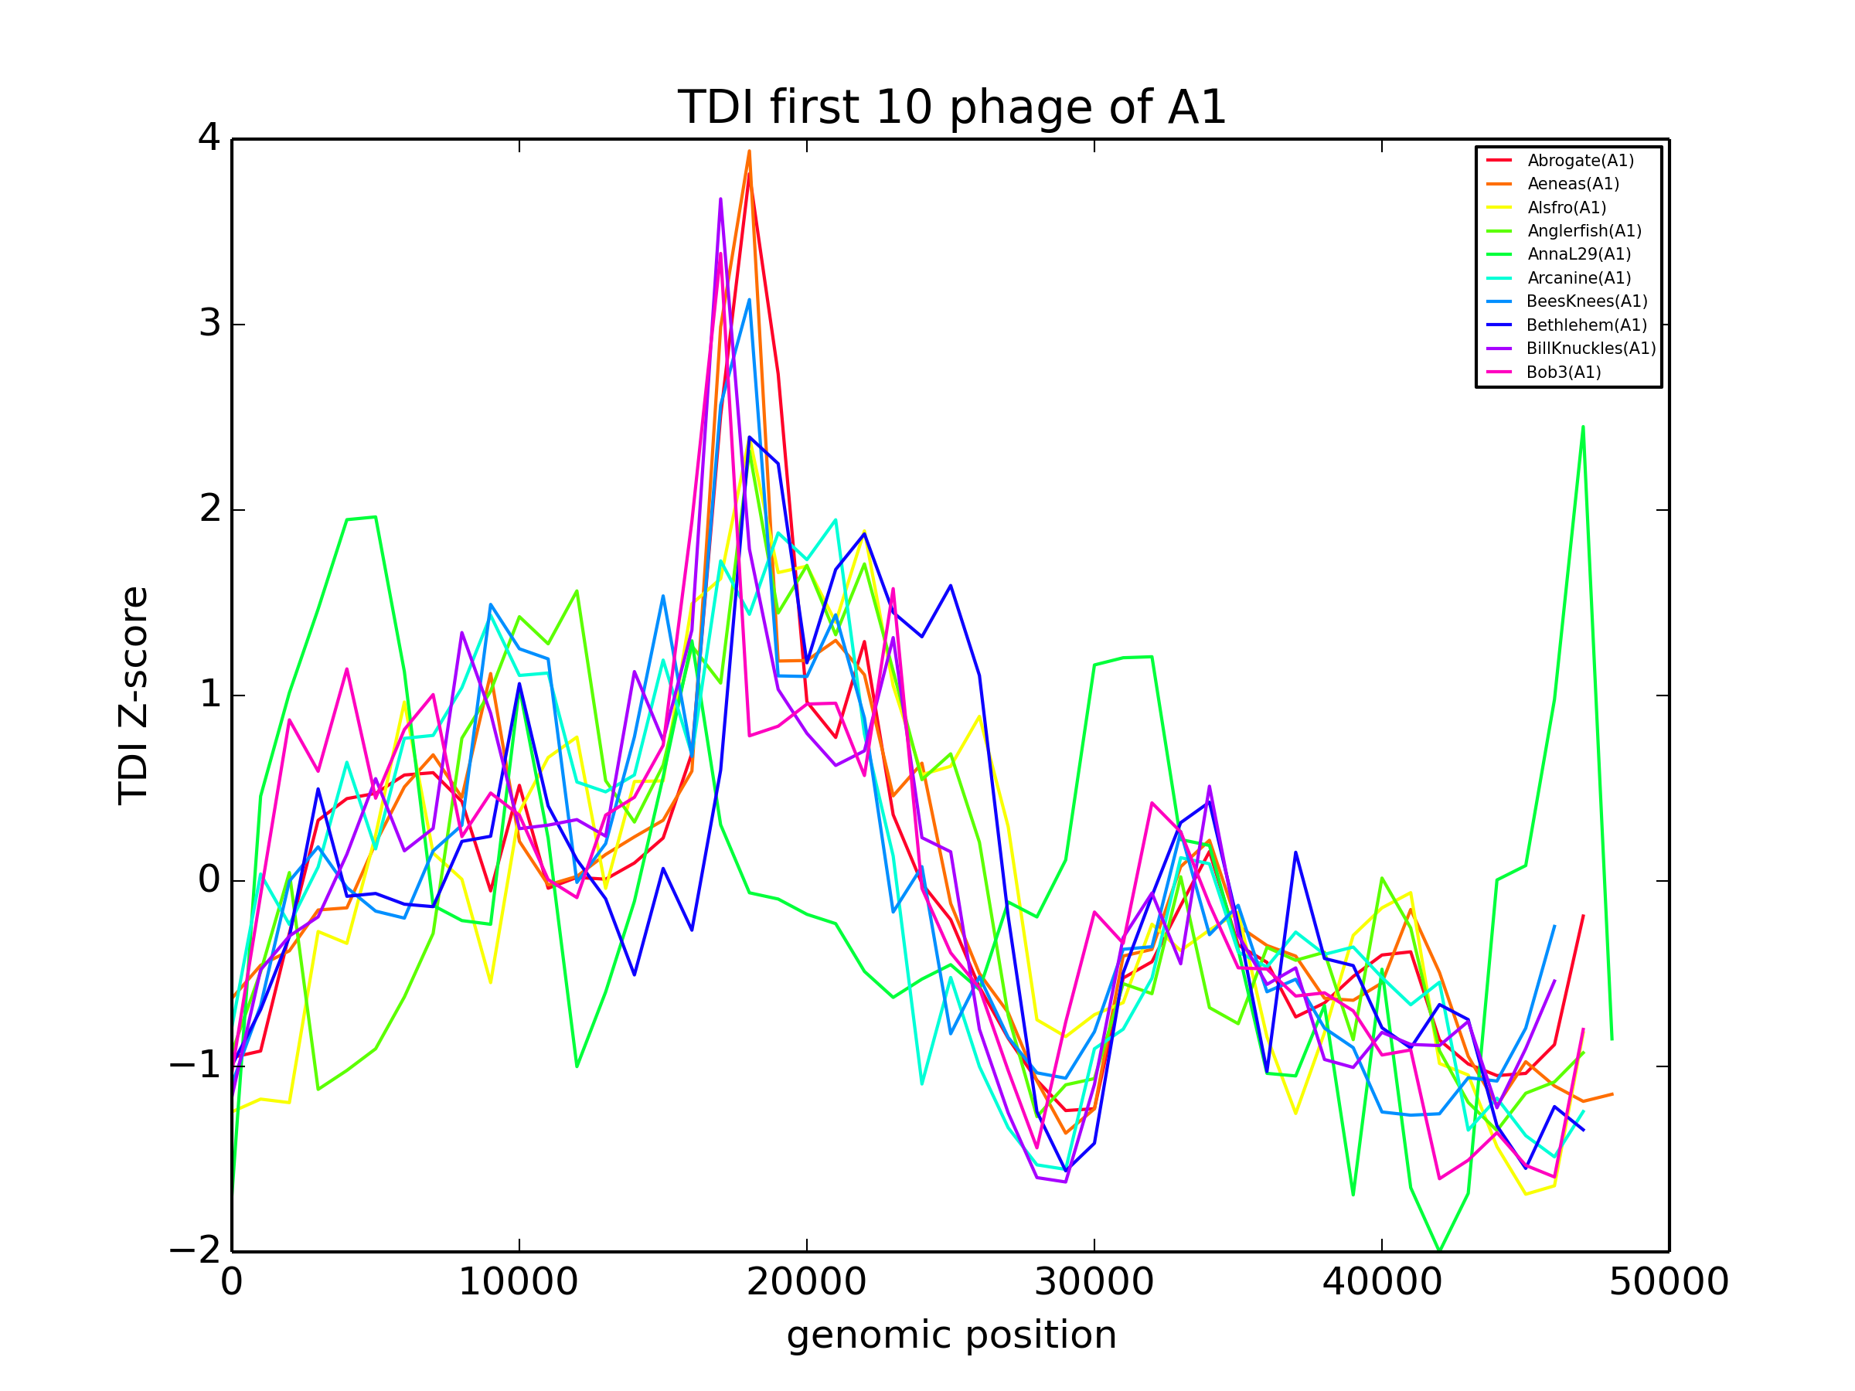

Slide 30
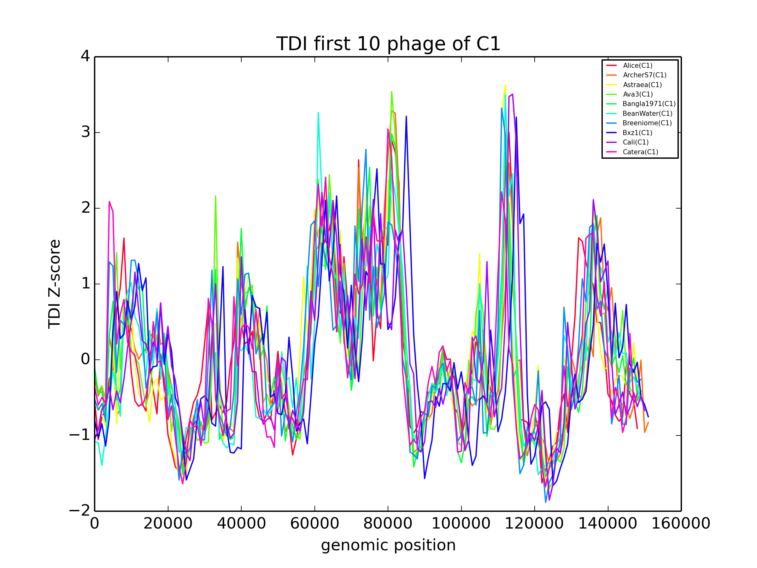

Slide 31
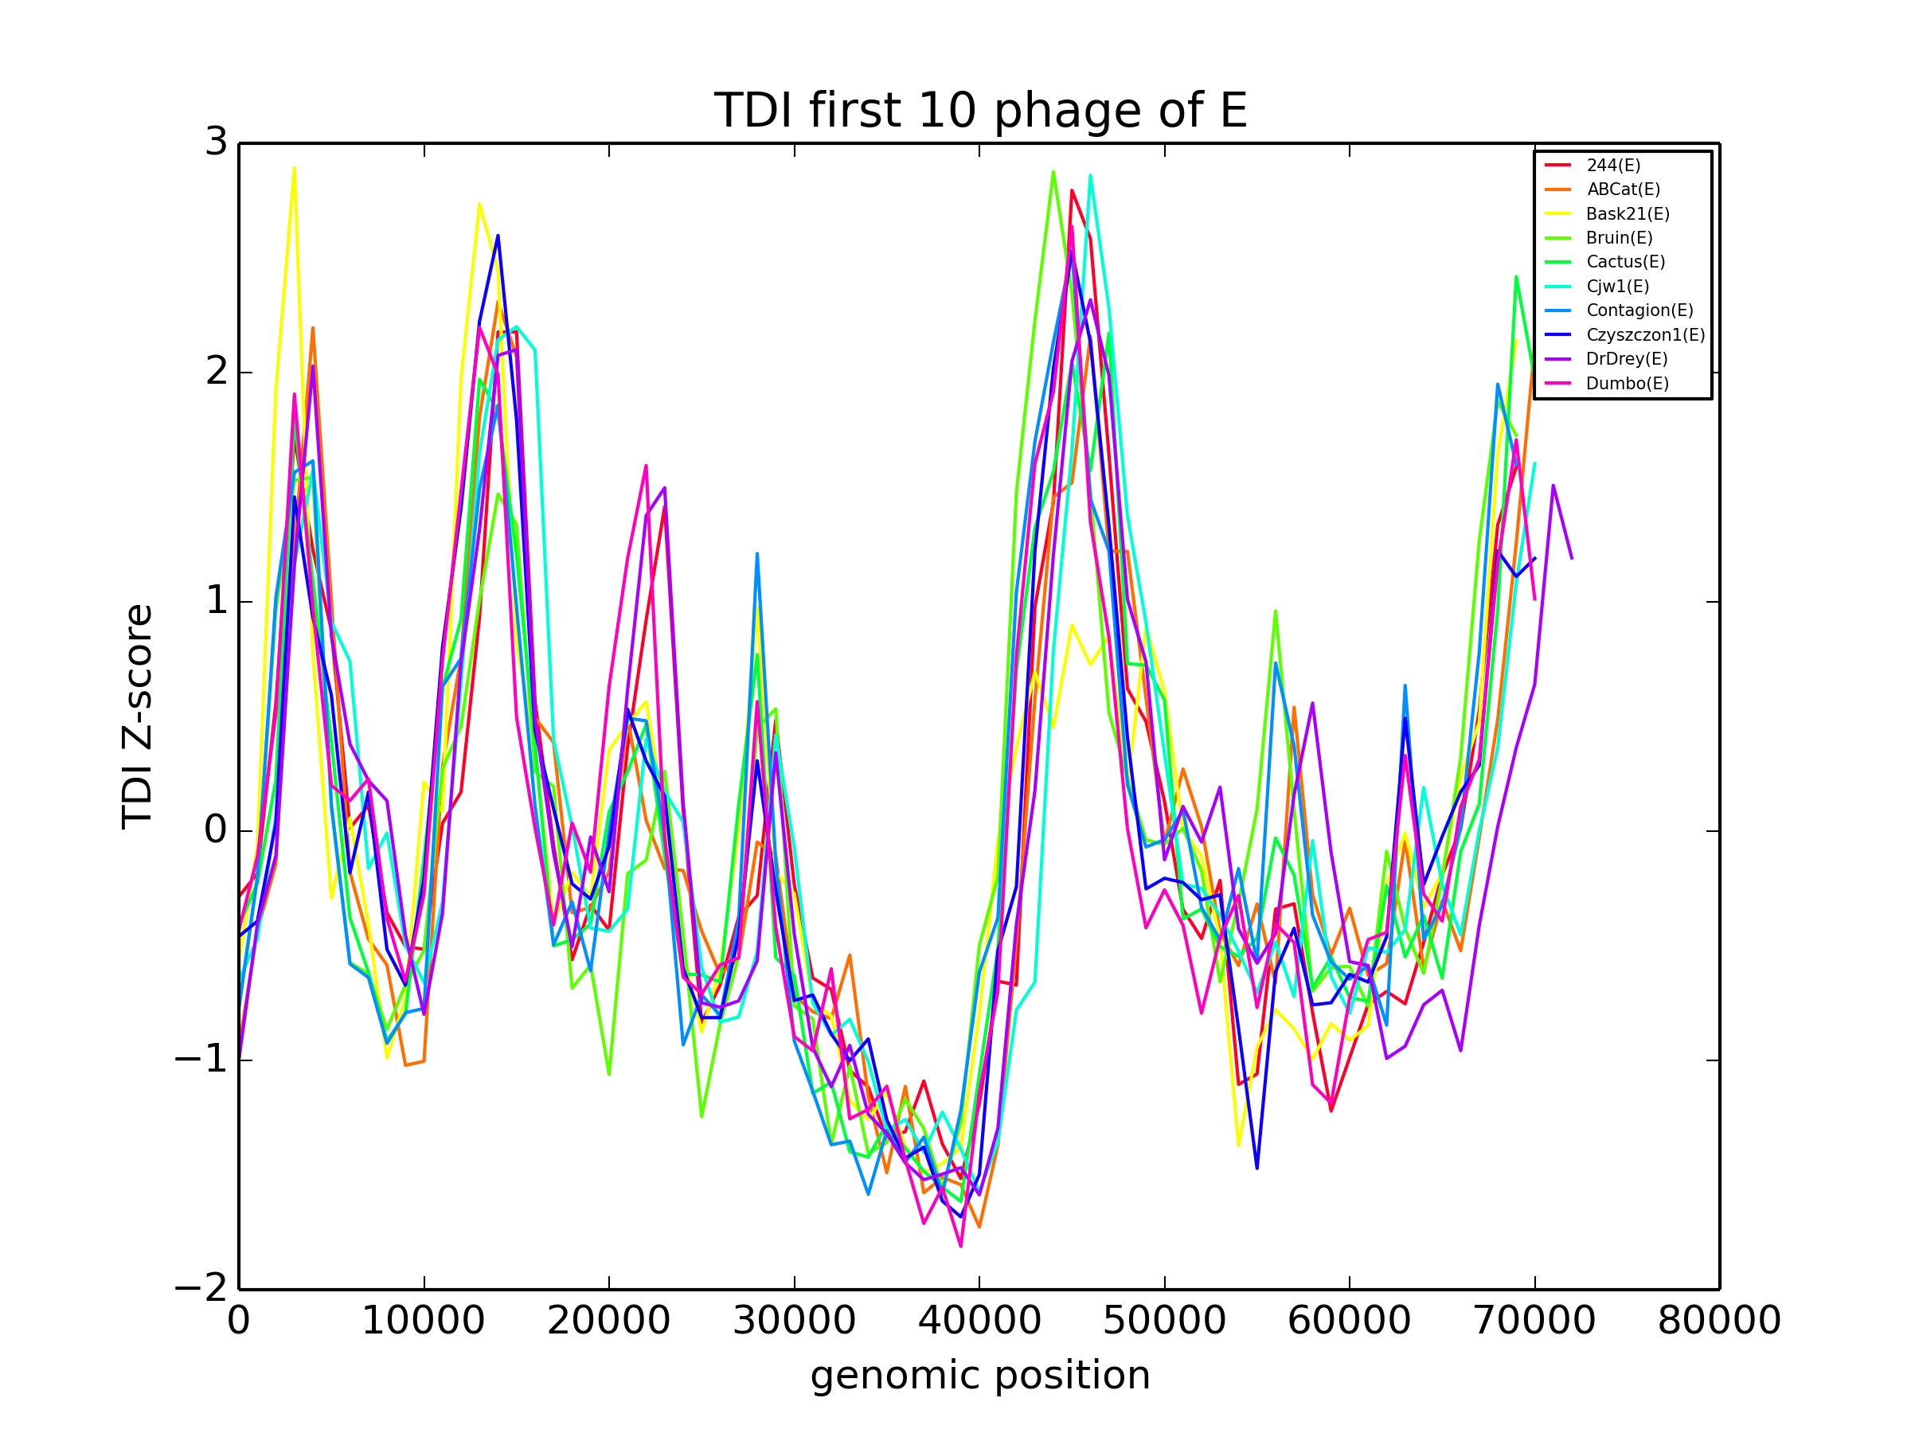

Slide 32
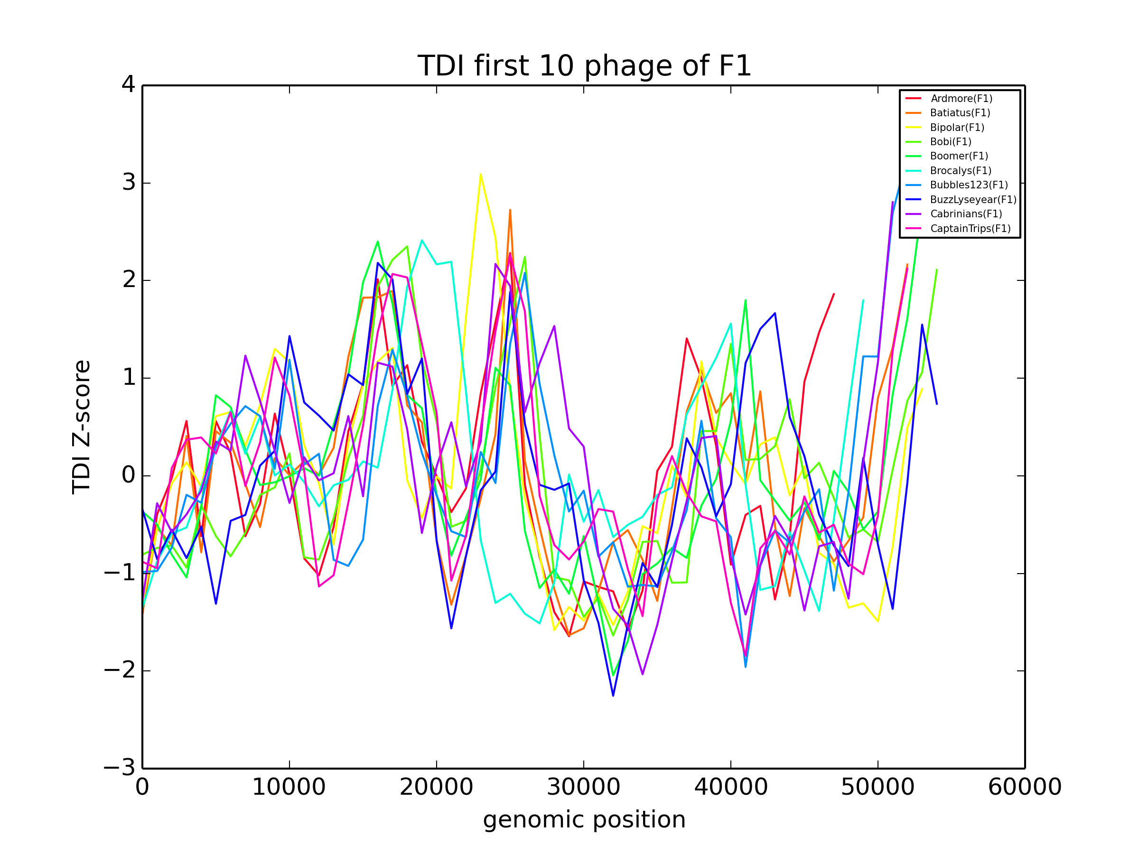

Slide 33
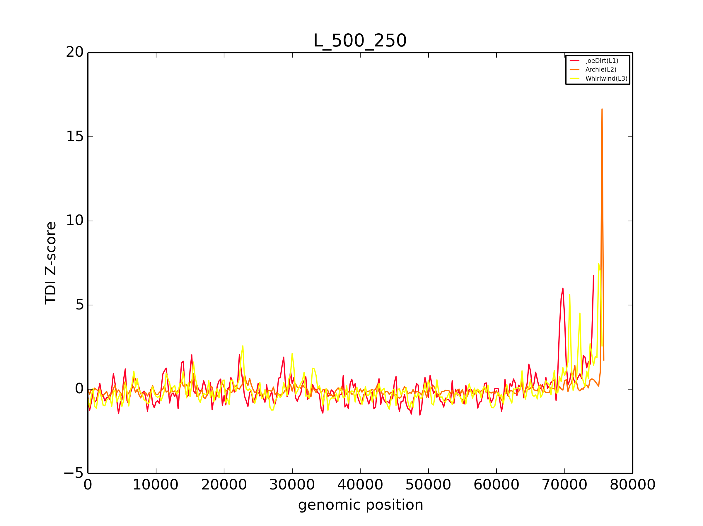

Slide 34
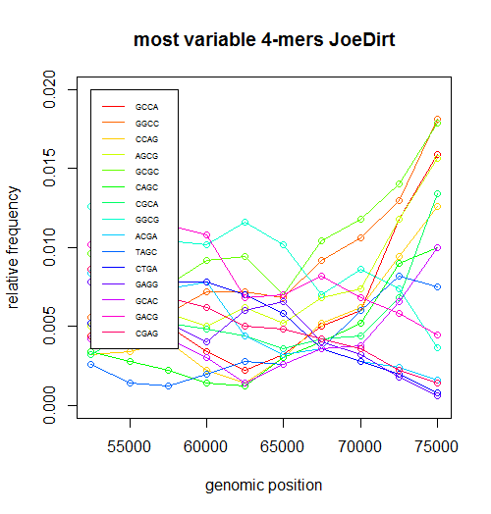

Slide 35
evidence of horizontal gene transfer?

Slide 36
BLAST results:
JoeDirt gp 130
Mycobacterium abscessus E = 2e-48
Flavobacterium psychrophilum E=2e-28
Streptomyces sp. E = 4e-28
Opitutaceae bacterium TAV1 ATPase E = 1e-23

Slide 37
some homology, but…

Slide 38
more likely:
Cluster L genomes are very repetitive at the end.
Repetitive regions have increased counts of specific 4-mers, contributing to the spike in TDI.

Slide 39
JoeDirt (L1) cluster of repeats at 70kb
70000

Slide 40
Archie (L2) cluster of repeats at 74kb and 76kb
74000
76000

Slide 41
there’s probably more stuff to put here

Slide 42
THANKS
questions?

